Slide 1
No Testing & Mastery Based Learning in Mathematics
Dr. Michael Opperman

Slide 2
Welcome
These slides are meant to be a summary into my recent work with a mastery-based, no test format in all of my mathematics classes
It is a work in progress and intended as an overview of my experiences thus far; it is far from complete
This work will continue and should be updated in the future

Slide 3
Three Goals
Unit exams have been removed from all of my courses
Evaluated courses:
MTH 180 - Introductory Statistics
MTH 250 - Matrices, Vectors, and 3D Math
Shifting from a unit exam based classroom to a weekly assessment based classroom has three major goals:
Support student mental health by reducing (if not eliminating) test anxiety
Improve overall quality of student work and normalize workload
Help students to retain more information by the end of the course

Slide 4
Student Mental Health
Test anxiety is a very real problem that many students experience
According to the Mayo Clinic, “feelings of worry and self-doubt can interfere with your test-taking performance and make you miserable”
The Princeton Review says “racing thoughts, inability to concentrate, or feelings of dread can combine with physical symptoms like a fast heartbeat, headache, or nausea”
To then measure student mental health, students were asked a IDEA survey question regarding their class experience with the alternate format to testing

Slide 5
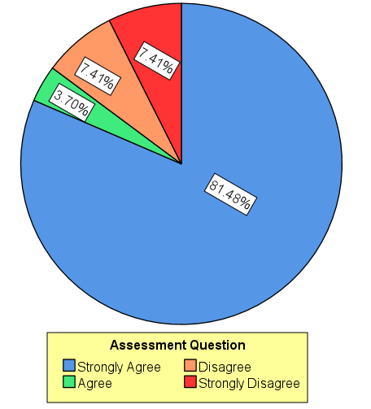
Self-Reported Well-Being
Student’s were asked How strongly do you agree/disagree with the following statement: (Spring 2020)
Overall, the use of "Weekly Assessments" over "Unit Exams" throughout the semester had a positive impact on my experience in the class.
Initial responses were overwhelmingly positive (Over 80%)
Unsure was an option but got no responses

Slide 6
Workload Balancing
Student work can be tracked with weekly assessments
It adds transparency for struggling students
You no longer need to wait until ‘The Test’ to realize a student is struggling
Students can correct a ‘bad grade’ without needing to curve a test or allow test corrections
Students to know where they struggle and can ‘fail forward’
It creates a regular routine for students
There is no break from content
Every week is a comparable amount of work
It makes grading throughout the class easier for faculty
There are no ‘heavy’ weeks with a lot of work to grade

Slide 7
Weekly Routine
Students enter a routine each week from the beginning of the semester
Every week is the same as the last with only slight variation
There are no review days
There are no test days
Removing tests allows the pace of the class to shift as well
More time can be spent on a topic or answering questions
You aren’t adding content; just shifting the workflow

Slide 8
Mastery-based Grading Format
I use a mastery-based gradebook in all of my classes
The goal of this (independent of giving tests) is to:
Eliminate ‘arbitrary’ weighting of homework/project/final/etc.
Reduce student focus on grade and increase student focus on actual learning
Add transparency for faculty and students so they know what the student does and does not understand during the course

Slide 9
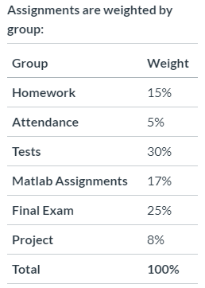
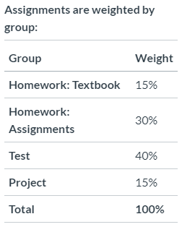
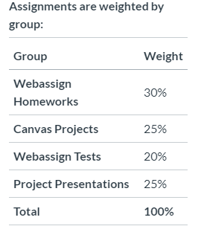
“Typical” Gradebooks

Slide 10
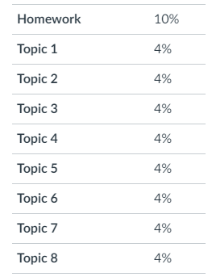
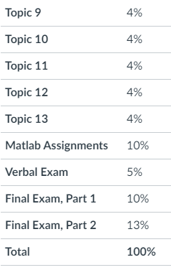
Mastery-Based Grades
Students are graded based upon the content in the course
Each topic is given equal weight
Topics map to the learning outcomes for the course
This allows students (and faculty) to track actual content knowledge

Slide 11
Topic Grades
Each topic consists of several (short) assessments
Students are given three tries to demonstrate mastery each topic
Their lowest score is dropped, allowing students to learn from their mistakes

Slide 12
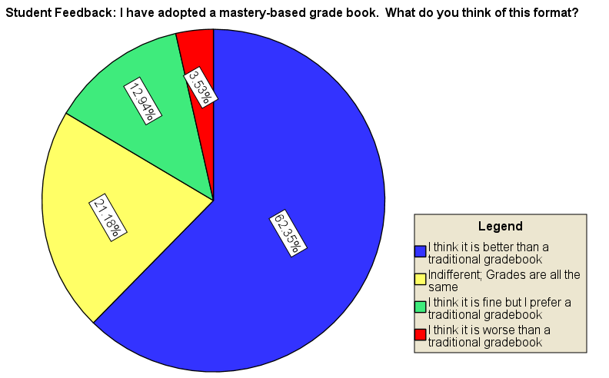
Feedback on Mastery Gradebook
Survey question given in 2019
More than 60% of students preferred the new gradebook
Less than 4% think it is worse

Slide 13
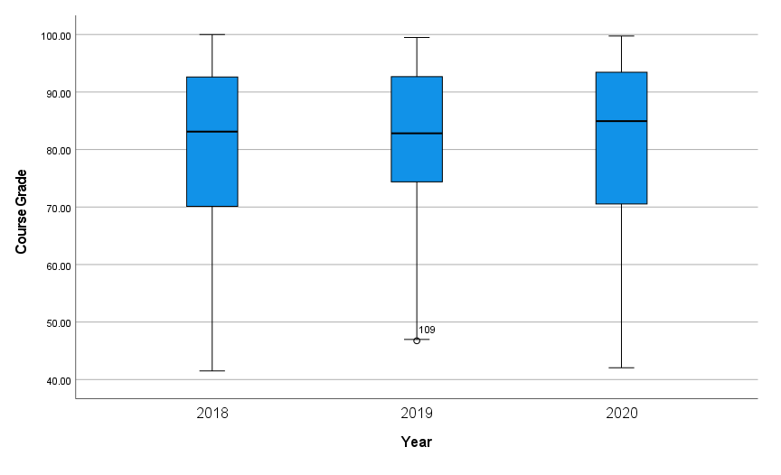
Student’s Final Grades
Introductory Statistics
2018/2019
Mastery Grades & Tests
2020
Mastery Grades but No Tests

Slide 14
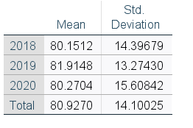
Analysis of Final Grades
An ANOVA test showing the distribution of grades by year
No significant difference is detected from one year to the next
Sample of 134 students over three years
Outliers have been removed prior to analysis
This consisted of very few students, many of whom did not even take the final exam

Slide 15
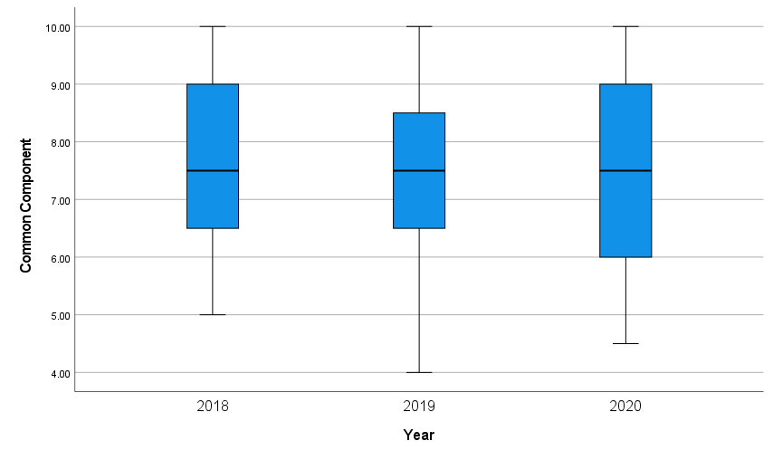
Student Common Component
Introductory Statistics
2018/2019
Mastery Grades & Tests
2020
Mastery Grades but No Tests

Slide 16
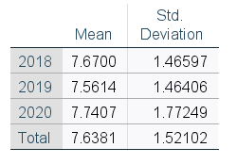
Analysis of Common Component
An ANOVA test showing the distribution of a common final exam component by year
No significant difference is detected from one year to the next
Sample of 134 students over three years
Students failing to take the final exam were removed from these results

Slide 17
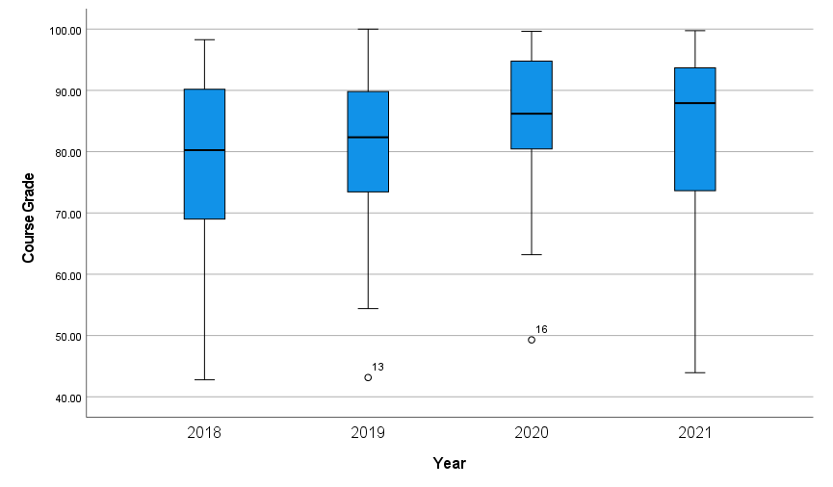
Student’s Final Grades
Matrices, Vectors, & 3D Math
2018
Traditional Grades
2019
Mastery Grades & Tests
2020/2021
Mastery Grades but No Tests

Slide 18
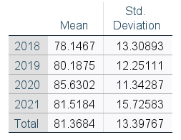
Analysis of Final Grades
An ANOVA test showing the distribution of grades by year
Statistically significant difference is detected from one year to the next
Sample of 189 students over four years
Outliers have been removed prior to analysis
This consisted of very few students, many of whom did not even take the final exam

Slide 19
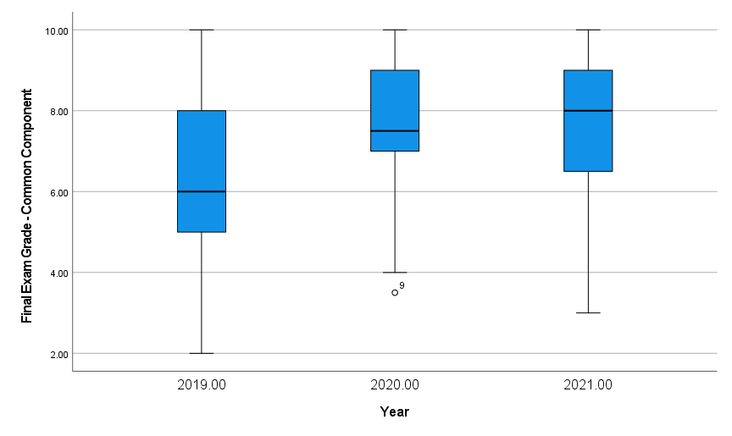
Student Common Component
Matrices, Vectors, & 3D Math
2018
No ‘common component’
2019
Mastery Grades & Tests
2020/2021
Mastery Grades but No Tests

Slide 20
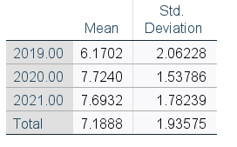
Analysis of Common Component
An ANOVA test showing the distribution of common final exam component by year
Significant difference is detected from one year to the next
While this may be partially attributed to flex-hybrid, no such pattern emerged in other courses
Sample of 139 students over three years
Students failing to take the final exam were removed from these results

Slide 21
(Initial) Conclusions
Students respond well to this alternate format of assessment and mastery-based grading
The final exam common component grade is similar (Introductory Statistics) if not improved (Matrices, Vectors, & 3D Math)
Overall grades are similar (Introductory Statistics) if not improved (Matrices, Vectors, & 3D Math)
The above findings in terms of grades may be due in part to remote learning and/or flex-hybrid; more analysis will be required before drawing any definitive conclusions
Personal workload improved on a weekly basis

Slide 22
Thank You!
For any questions or feedback, you can contact me at: mopperman@champlain.edu

